Slide 1
Implementing the word count example using Apache Spark

Slide 2
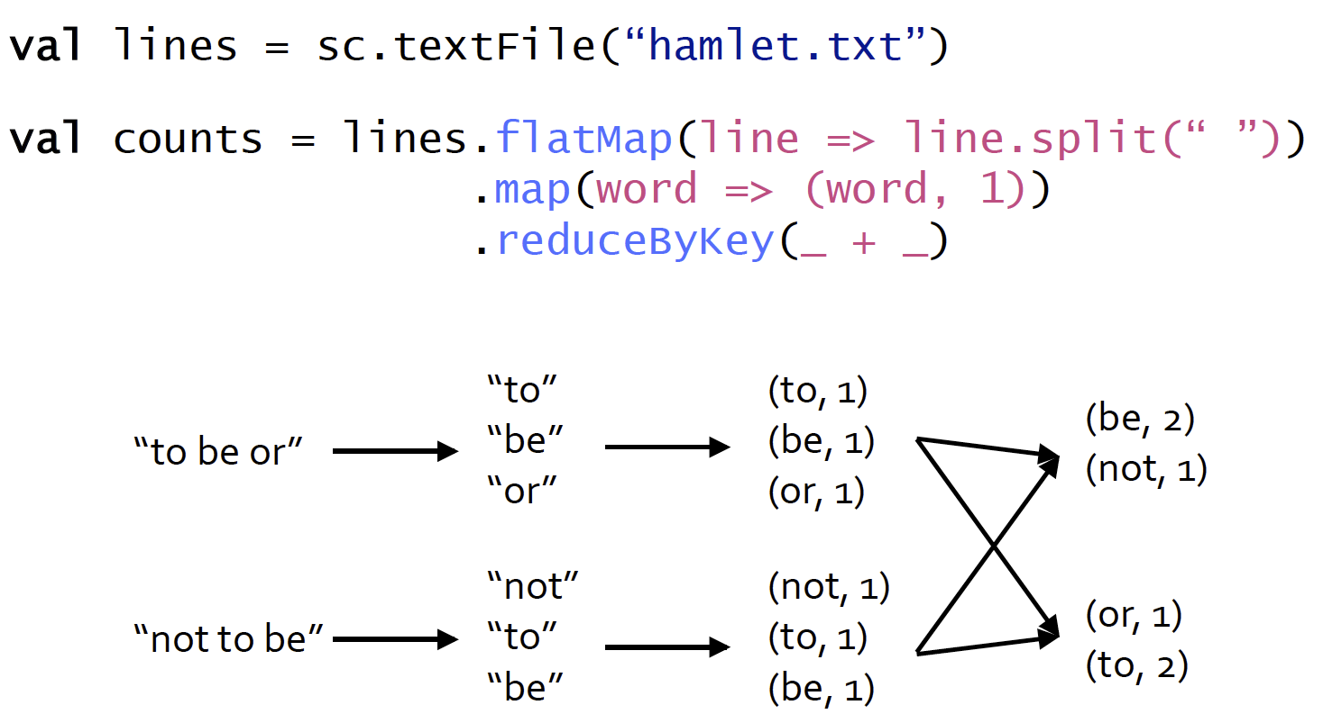
Word Count Example

Slide 3
How do we do topK words?
counts.map( x => (x._2, x._1) ).sortByKey(false).take(20)
or
counts.sortBy(x => x._2, false).take(20)
or
counts.map( {case(word, count) => (count, word)} ).sortByKey(false).take(20)
The above example returns the top 20 words in order of descending count
The map function flips the word and count key-value pairs.
Next we sort the data by the new key of count
Finally we take the top 20 tuples from the final RDD.
It is important to note after each function call above a separate RDD is produced.
So the counts.map … line creates 3 intermediate temporary RDDs.

